Slide 1
Barcode Reader Database and Inventory System
Carlos Salas | Ada Pluguez

Slide 2
System Description
Our project will keep track of a store’s inventory
Admin Can Update Inventory Product Amounts, Update Product Price, Add New Products, Or Delete Existing Products
Inventory Clerk Can Update Inventory Product Amounts or Lookup Unit Price
Git: https://github.com/adaPlu/Barcode-Reader-CSE111

Slide 3
Use-case
Details
Admin and Inventory Clerk Use Cases:
Look Up Item
Entry Condition: Click Look Up Item
Scan Item
Select Price or Inventory
Display Price or Inventory From Database
Exit Condition: Click Exit
Manage Inventory
Entry Condition: Click Manage Inventory
Scan Item
Select Add or Remove
Enter Amount to be Added or Removed
Edit Inventory Amount in Database
Exit Condition: Click Done
Scanning
Entry Condition: Manage Inventory Scan/Look Up Item Scan
Scan Item
Exit Condition: Item Scanned

Slide 4
Use-Case
Details
Cont.
Admin Only Use Cases:
Update Price
Entry Condition: Click Update Price
Scan Item or Enter bar Code
Enter New Price
Change Price in Database
Exit Condition: Click Done
Add Product
Entry Condition: Click Add Product
Scan Item or Enter Barcode
Enter Product Type
Enter SupplierID
Enter Amount of Product Received
Add Product to Database
Exit Condition: Click Done
Remove Product
Entry Condition: Click Remove Product
Scan Item or Enter Barcode
Remove Product From Database
Exit Condition: Click Done

Slide 5
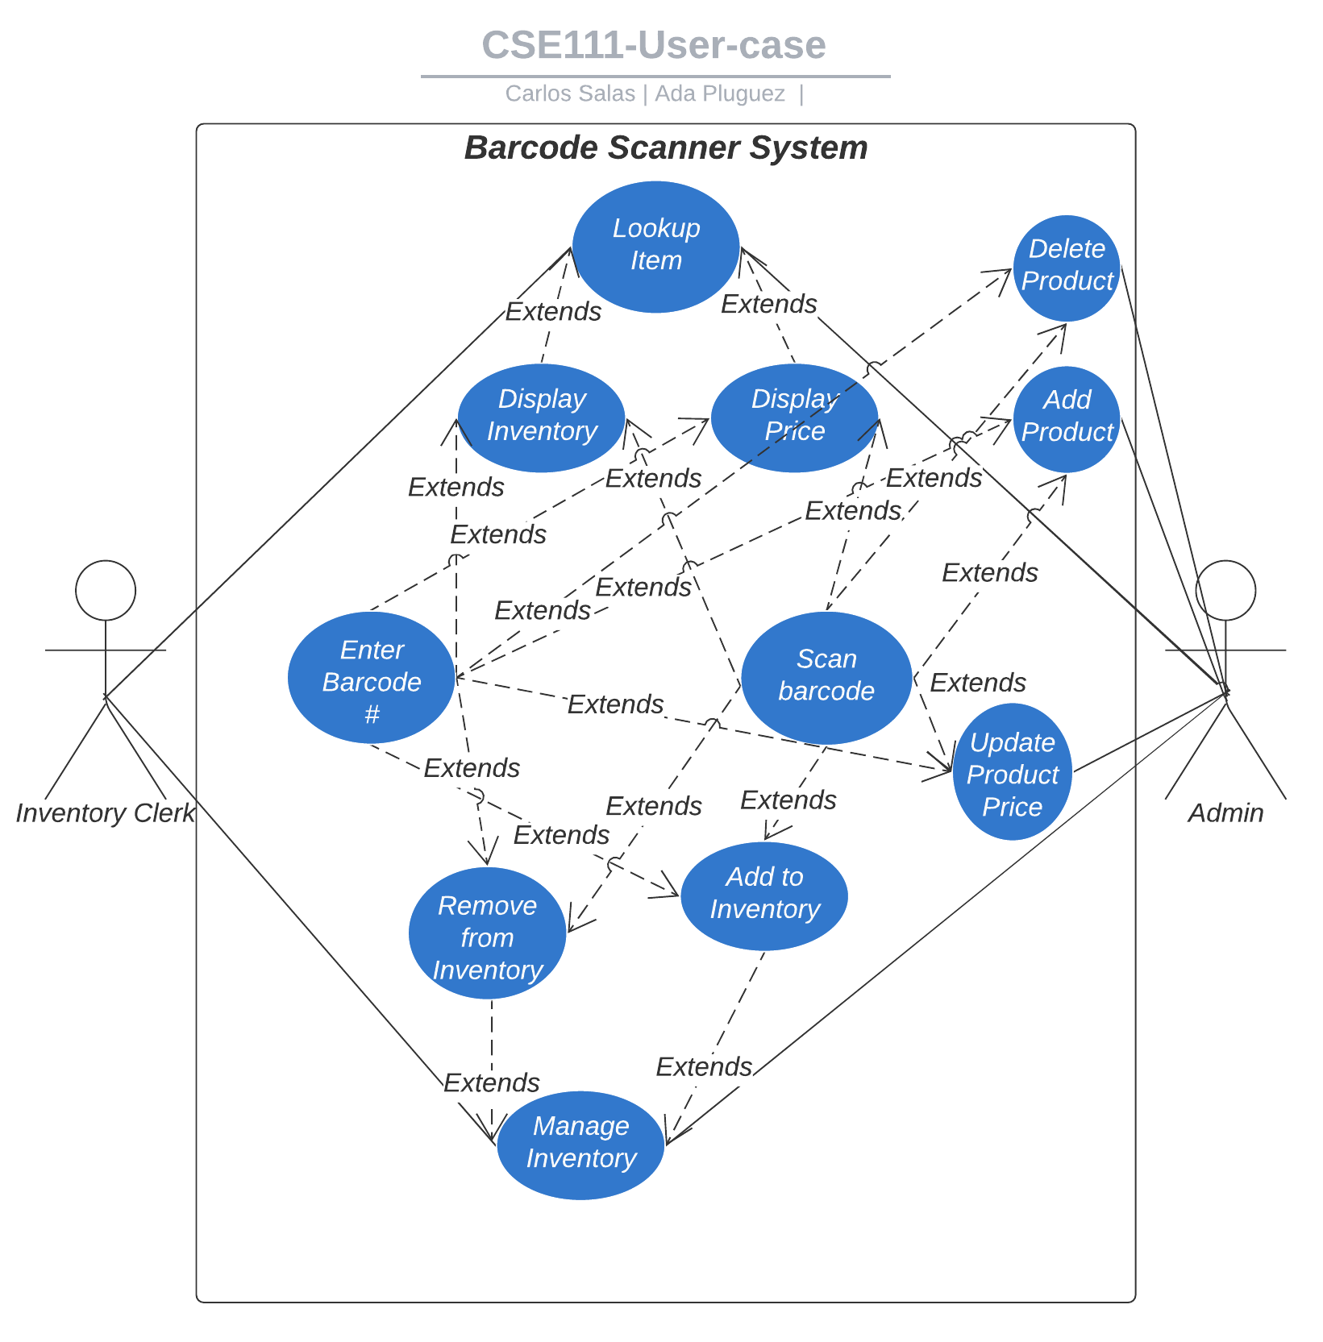
Use-case Diagram

Slide 6
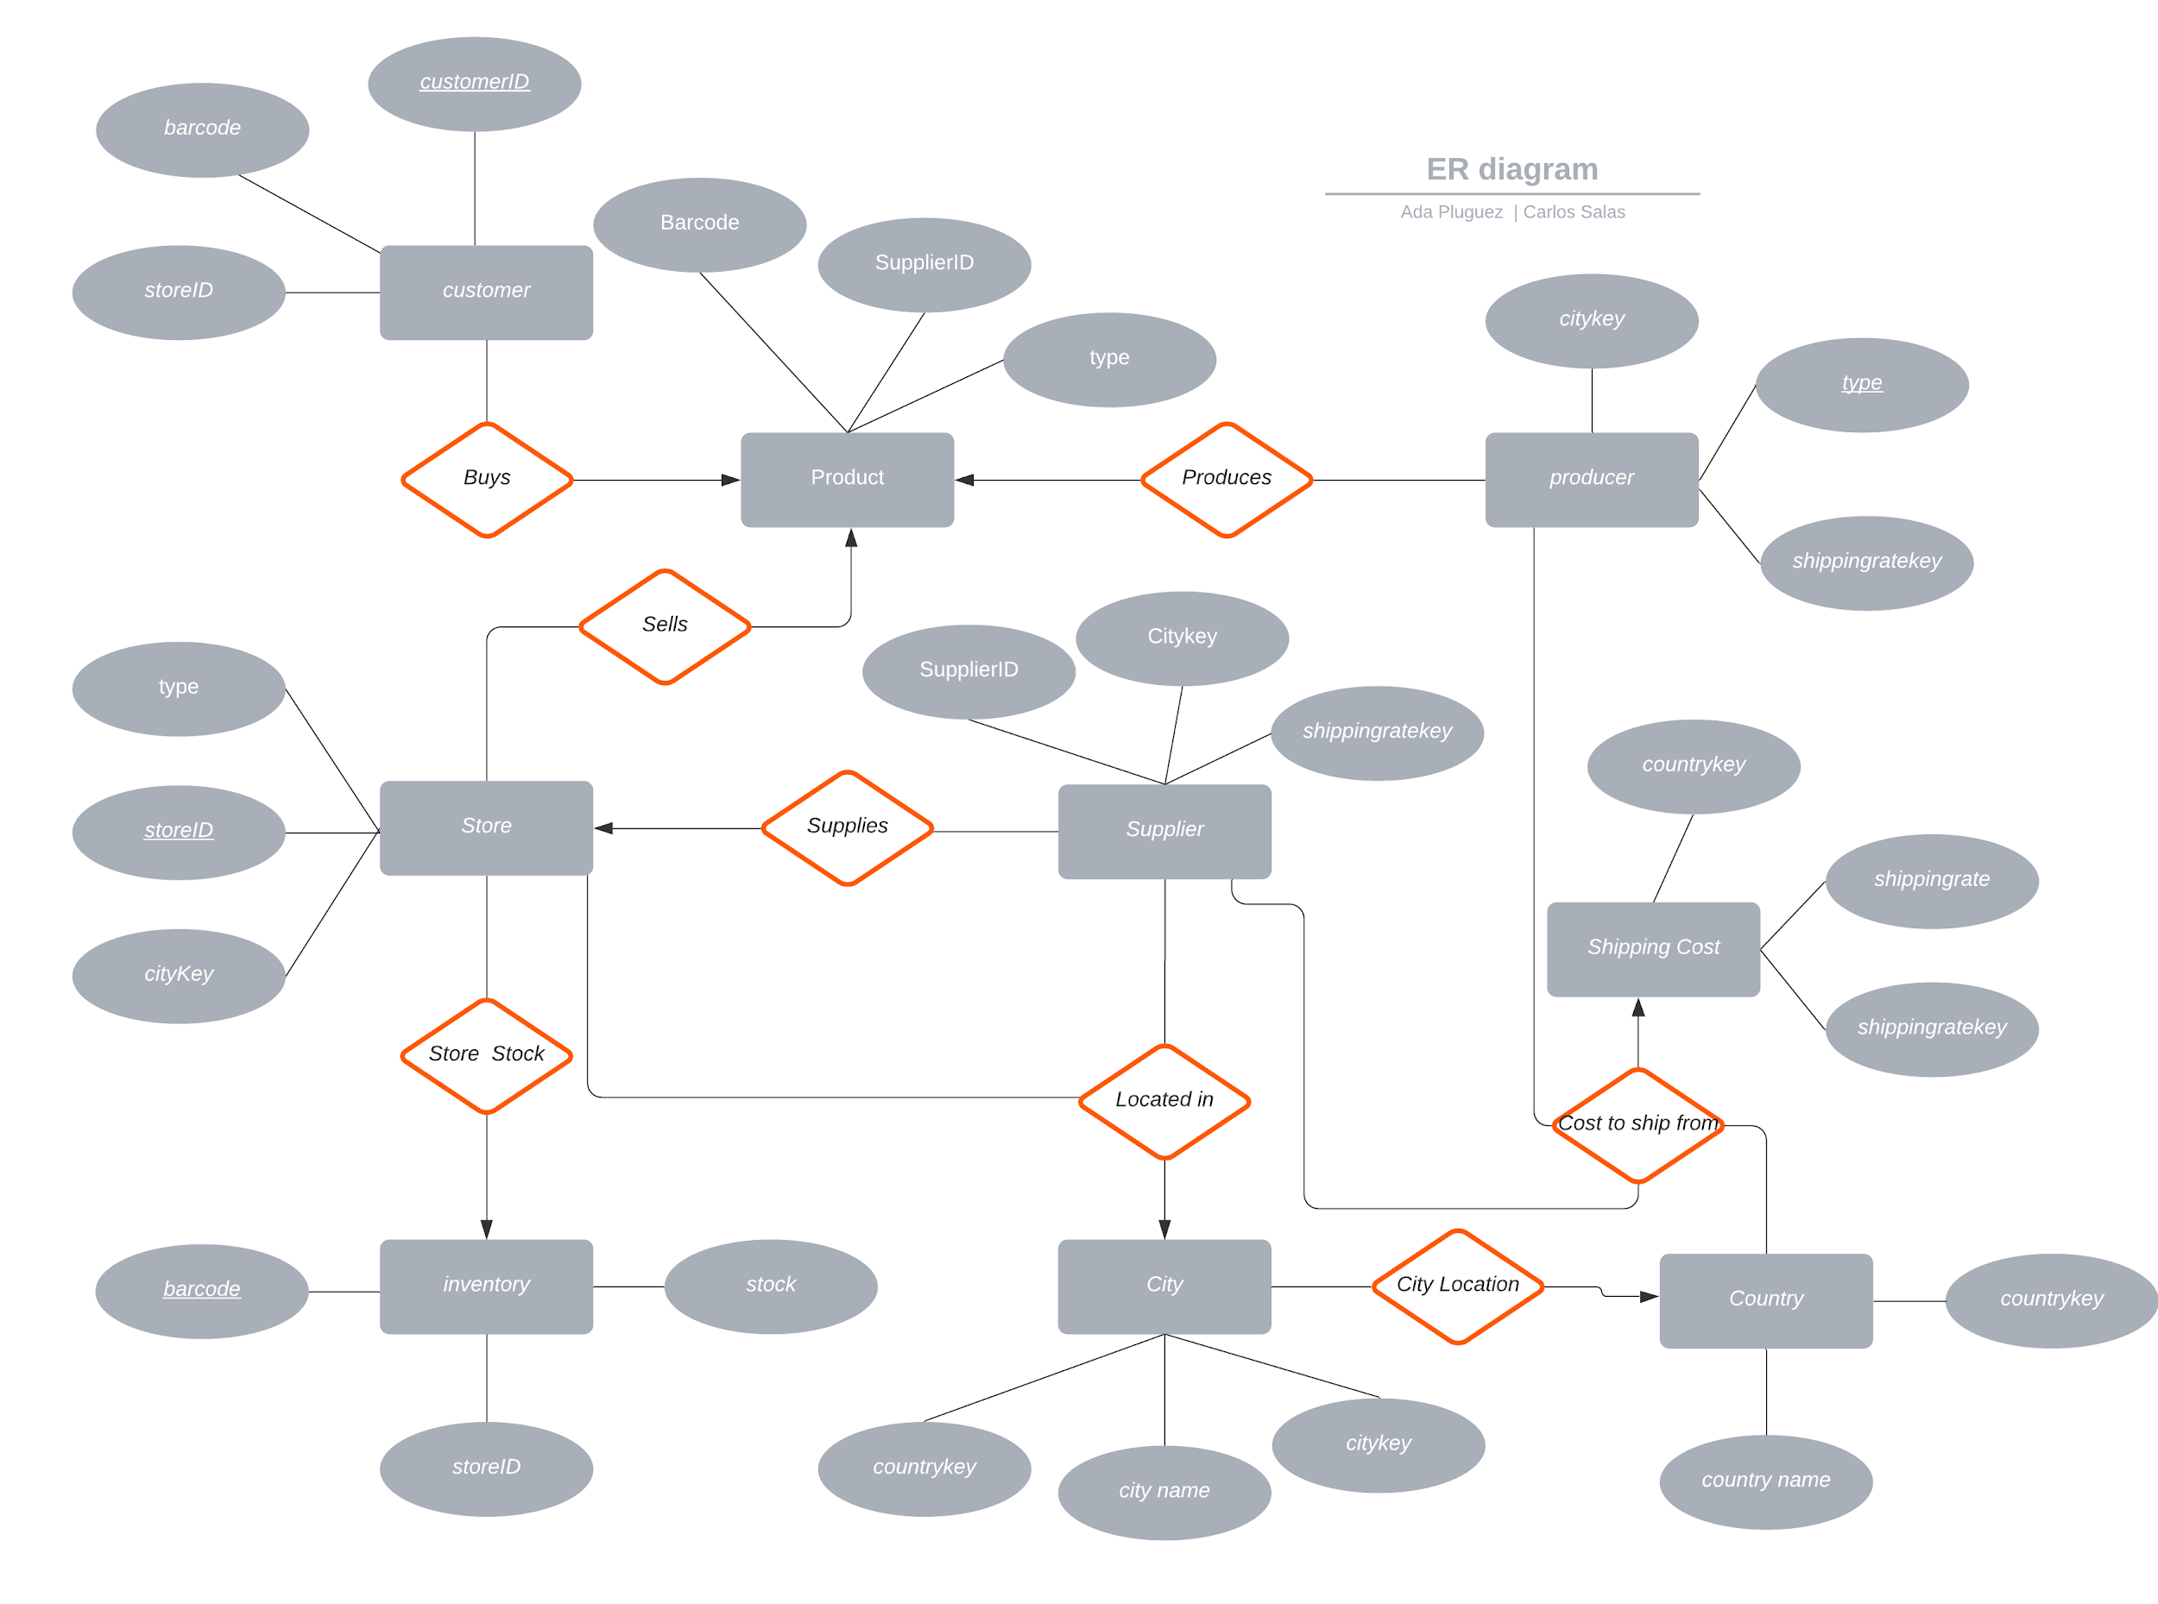
E/R Diagram

Slide 7
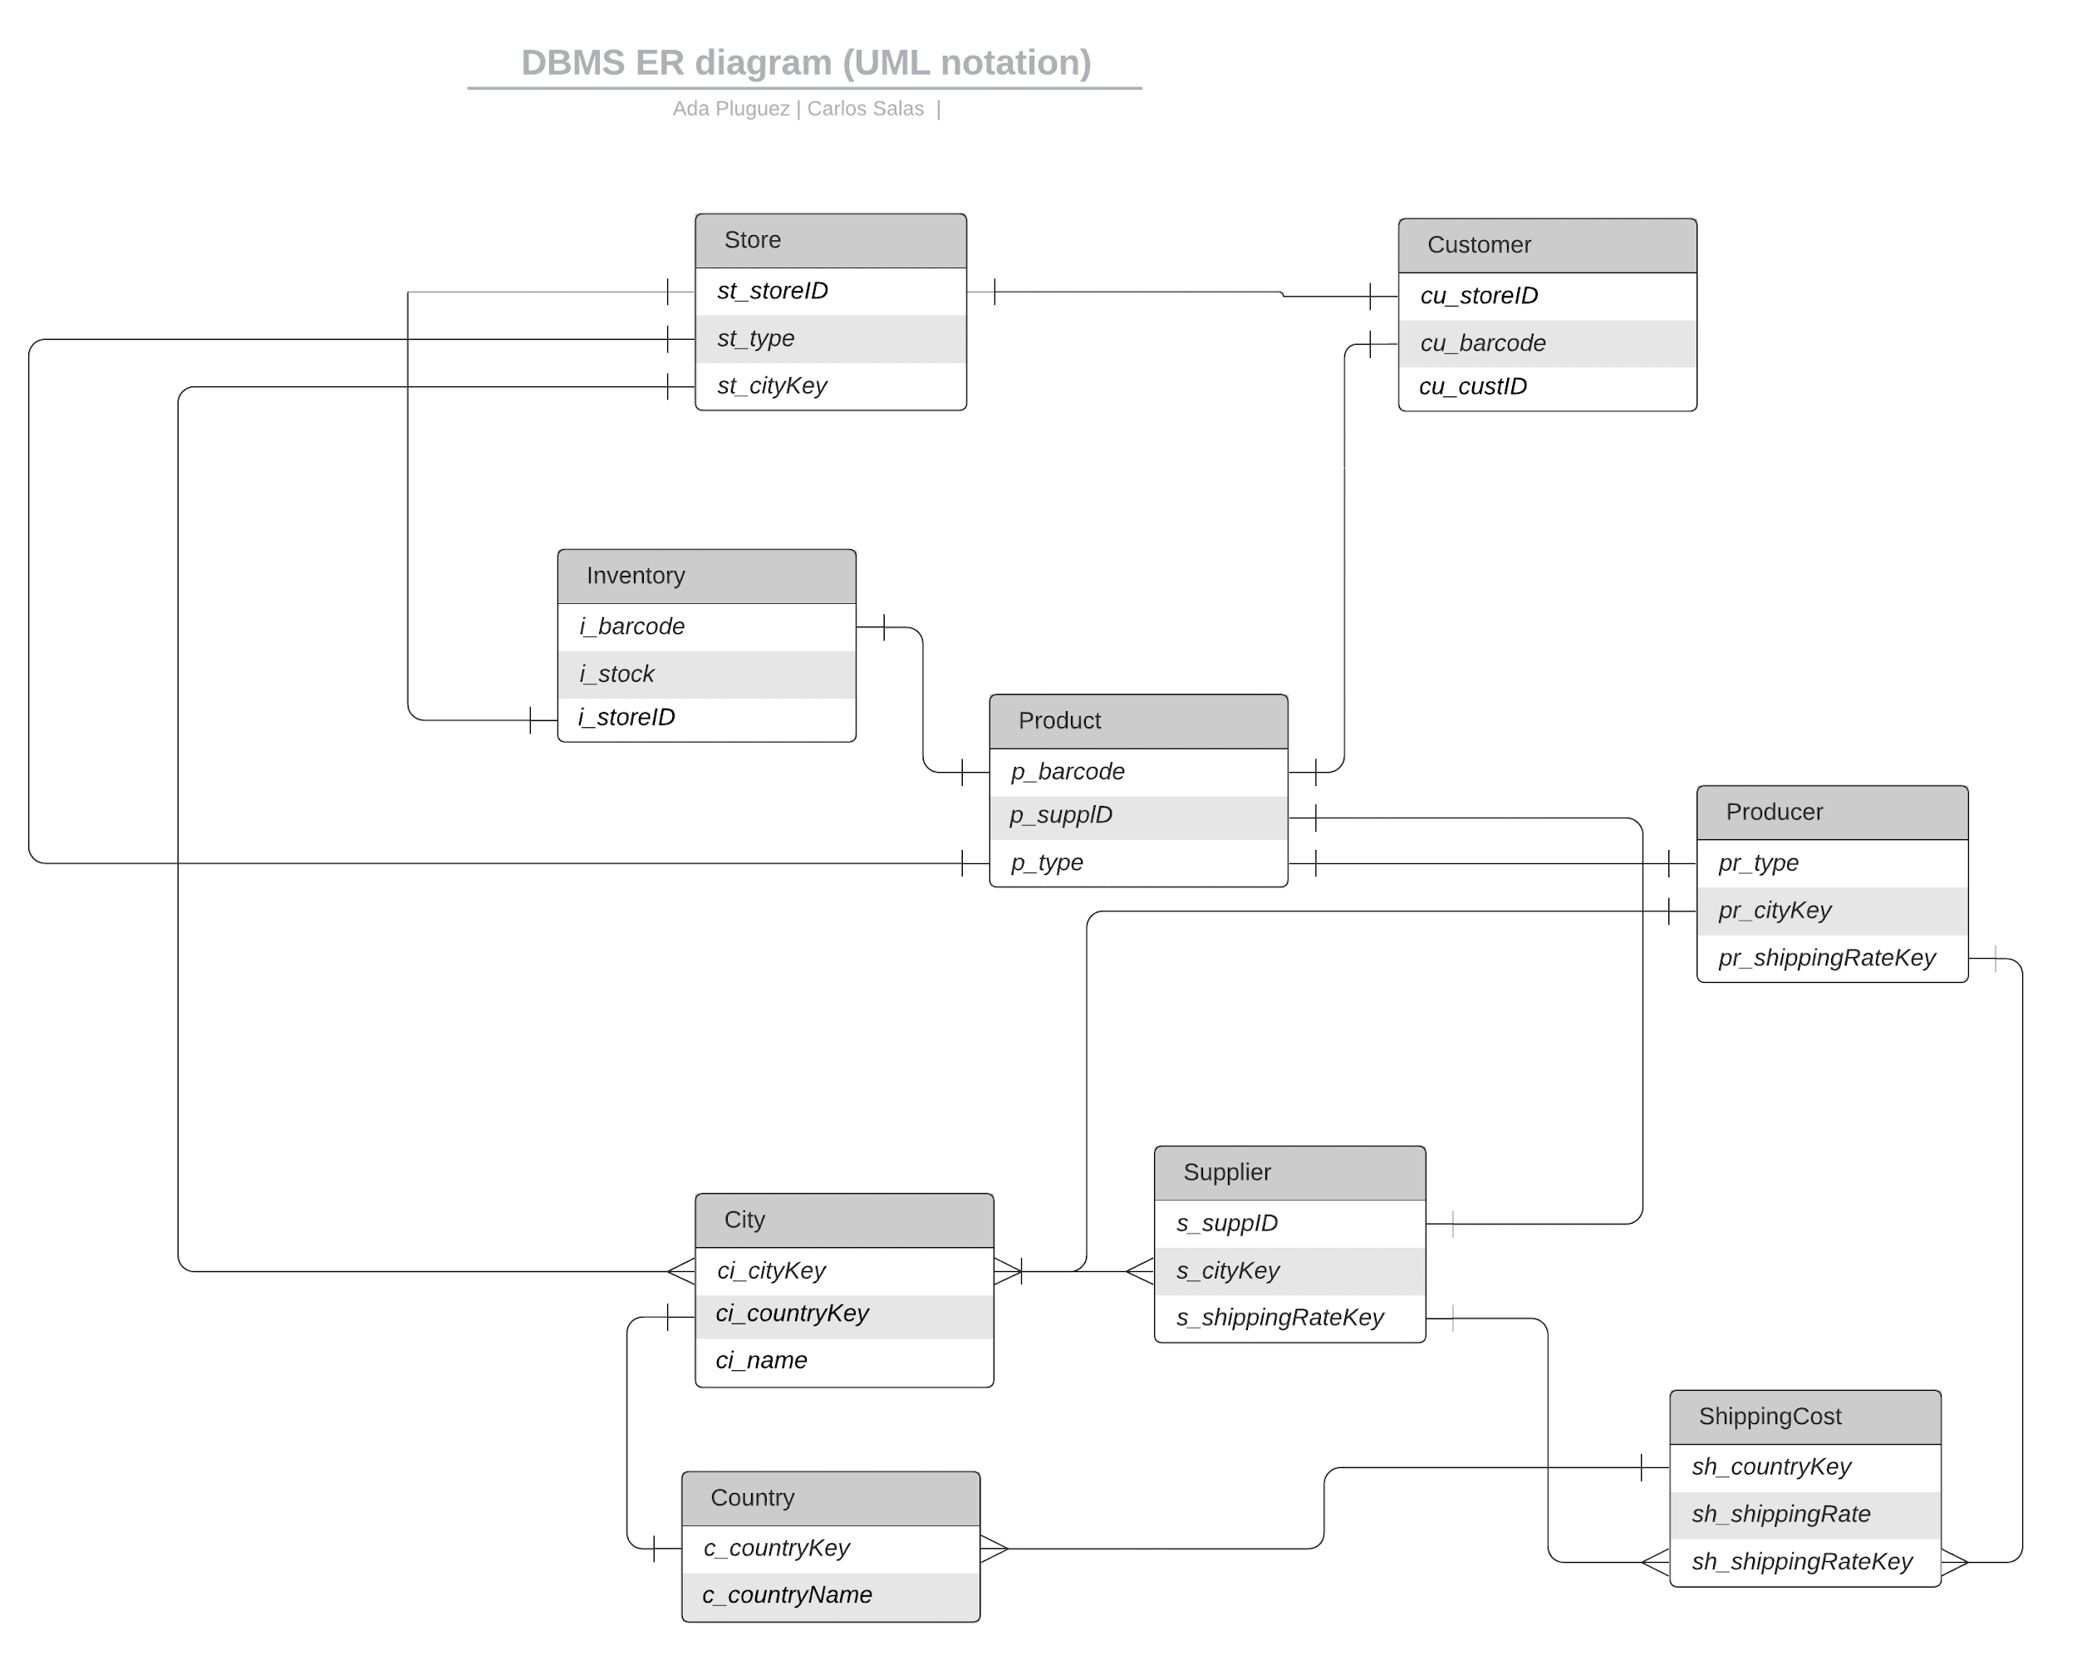
Relational Schema

Slide 8
Tables
Inventory
- i_barcode INT
- i_stock INT
- i_storeID INT
Producer
- pr_type VARCHAR
- pr_cityKey INT
- pr_shippingRateKey INT
Supplier
- s_supplierID INT
- s_cityKey INT
- s_shippingRateKey INT
Product
- p_barcode INT
- p_supplierID INT
- p_type VARCHAR
Customer
- cu_storeID INT
- cu_barcode INT
- cu_customerID INT
Store
- st_storeID INT
- st_cityKey INT
- st_type VARCHAR
Shipping Cost
- sh_countryKey INT
- sh_shippingRate DECIMAL
- sh_shippingRateKey INT
Country
- c_countryKey INT
- c_name VARCHAR
City
- ci_cityKey INT
- ci_countryKey INT
- ci_name VARCHAR

Slide 9
Thank You

